Slide 1
C-STORE OFFICE
ADVANCED ACCOUNTING – Creating a new account in the Chart of Accounts

Slide 2
Agenda
Where is the chart of accounts located in CStore?
How do I add a new account?
Why would I need to add a new account?
What information is needed to complete a new account?
Where does this appear in CStore?

Slide 3
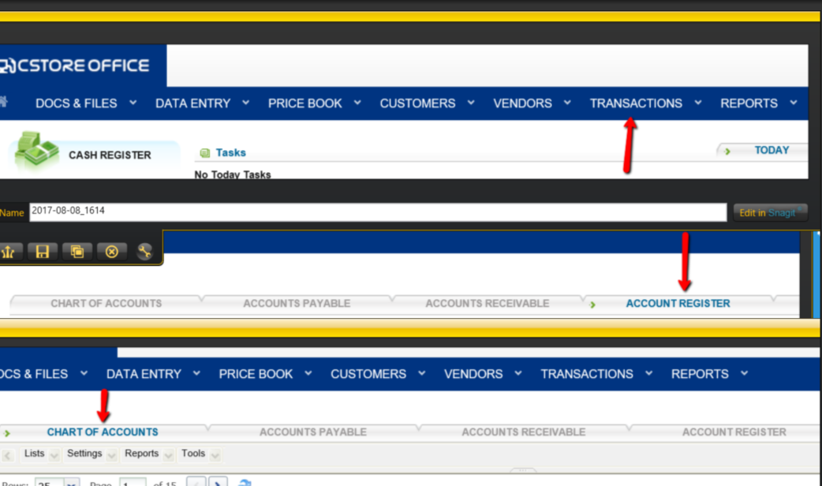
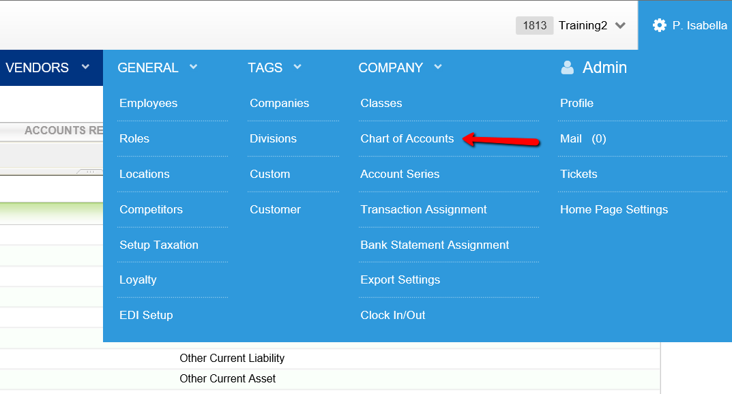
WHERE ARE THE CHART OF ACCOUNTS LOCATED IN CSTORE?
Option 1: Transactions > Account Register > Chart of Accounts tab
Option 2: At the top right corner of C-Store, beside your account name, click the settings icon, and then click Chart of Accounts.
Option 1
Option 2

Slide 4
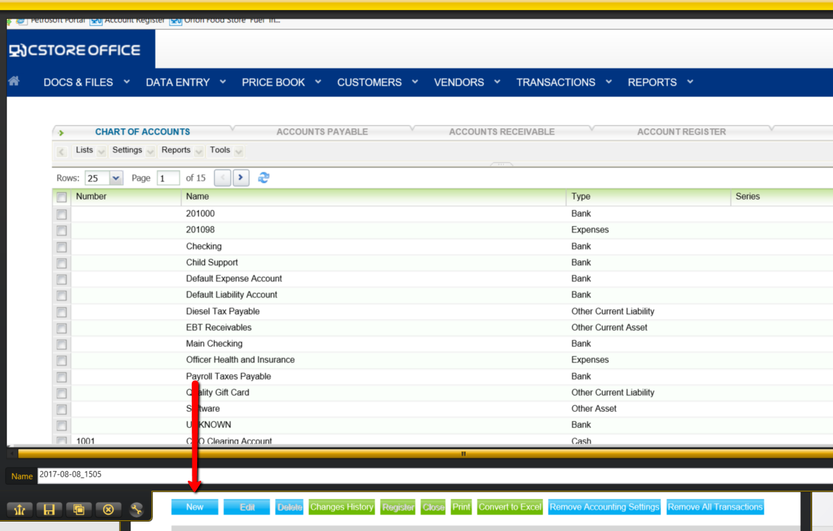
HOW DO I ADD A NEW ACCOUNT?
Click the New button.

Slide 5
WHY DO I NEED TO ADD A NEW ACCOUNT?
C-Store gathers data from your cash register: if you want to track new information and do not have it in your current chart of accounts, you need to add it to allow data to capture the information
Business additions and subtractions: If you need to add/delete bank accounts, payable/receivable, fixed assets, income, liabilities, assets, cash, cost of goods sold, and expenses

Slide 6
INFORMATION NEEDED TO CREATE A NEW ACCOUNT

Slide 7
INFORMATION NEEDED TO CREATE A NEW ACCOUNT
FOR EXPENSES: The set up is the same as the first example except you can check off accessible in data entry so that managers can expense store supplies and other miscellaneous costs

Slide 8
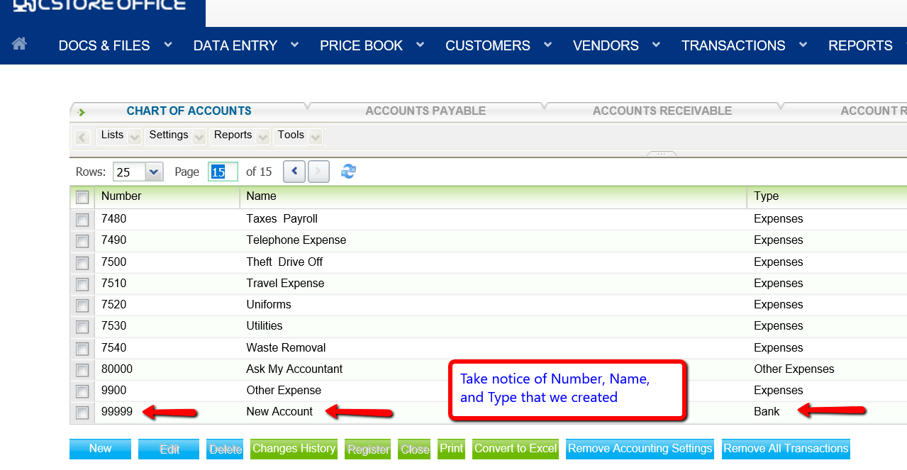
WHERE DOES MY NEW ACCOUNT APPEAR?
You can apply filters directly to find the account or click through to find the newly inserted account

Slide 9
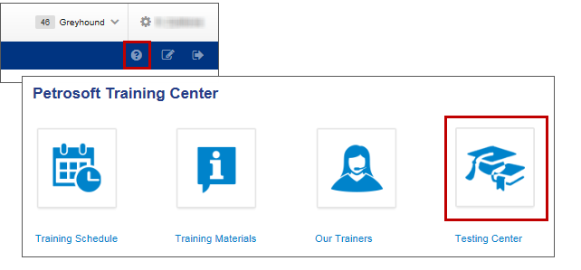
TRAINING CENTER
For additional testing on what you have learned, please refer to our new “Testing Center”.
To access this new feature, click the help icon, and then select Testing Center.

Slide 10
THANK YOU FOR YOUR TIME!
Get in Touch
www.cstoreoffice.com
Petrosoft LLC
290 Bilmar Drive
Pittsburgh, PA 15205
1.412.306.0640

